Slide 1
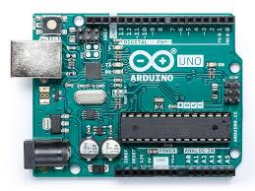










Computer
Slave 1 (0x08)
Train
Controls the location of the train
Interfaces with the ultrasonic sensor
Processing
GUI (sliders/buttons)
Communicates with Arduino
Slave 2 (0x09)
Dispenser
Controls the stepper motors of the dispenser
USB
Slave 3 (0x10)
Gripper
Stepper motors
Servos
Limit switches
Slave 4 (0x11)
Mixer/Former
Controls the motors of the mixer and former
I2C Communication
Master (0x00)
Running main code

